Slide 1
Natural Language Processing (NLP)
By
Dr. Ravirajsinh S. Vaghela
Assistant Professor, SCSFD.
NFSU,Gandhinagar

Slide 2
Introduction
Natural Language Processing (NLP) is a subfield of machine learning which leverages analysis, generation, and understanding of human languages to derive meaningful insights.
NLP is becoming popular as Large Language Models (LLMs) are growing and used widely in the market. Having foundational knowledge of NLP concepts and techniques can help you become an NLP data scientist, NLP engineer, or distinguished ML engineer to stand out in the job market.

Slide 3
NLP topic to understand
Text pre-processing
Text feature extraction
Text sort
Named entity recognition
Parts-of-speech tagging
Text generation
Text-to-speech and speech-to-text techniques

Slide 4
Text pre-processing
Pre-processing techniques such as tokenization, stemming, and lemmatization, help convert raw text into a format that can be easily analyzed.
Tokenization
The fundamental concept in NLP is tokenization.
It is the process of breaking down a complex piece of text into smaller units called tokens.

Slide 5
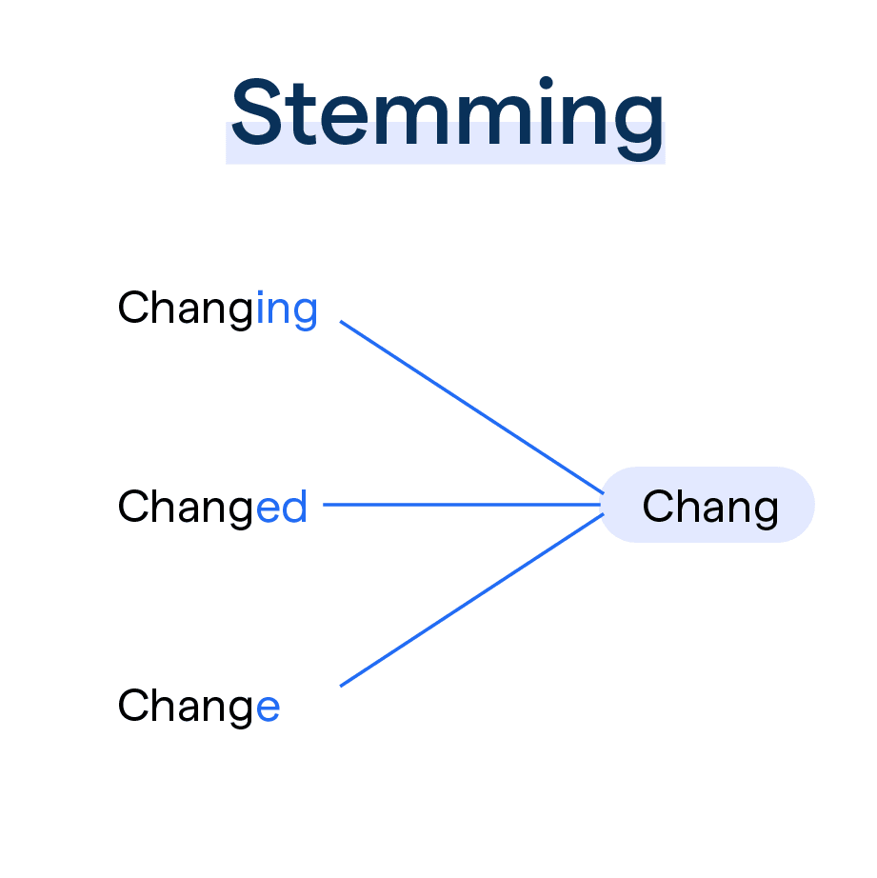
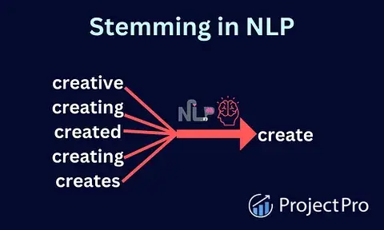
Stemming
Stemming is the process of reducing words to their base or root form. This can be useful in classification or information retrieval tasks.

Slide 6
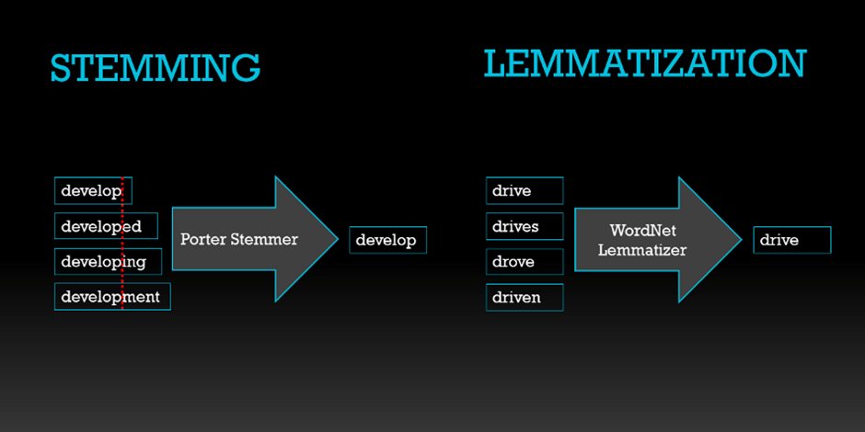
Lemmatization
Lemmatization is the process of reducing a word to its base or root form, which is known as the lemma. It is a more sophisticated version of stemming, as it takes into account the context and the part of speech of the word.

Slide 7
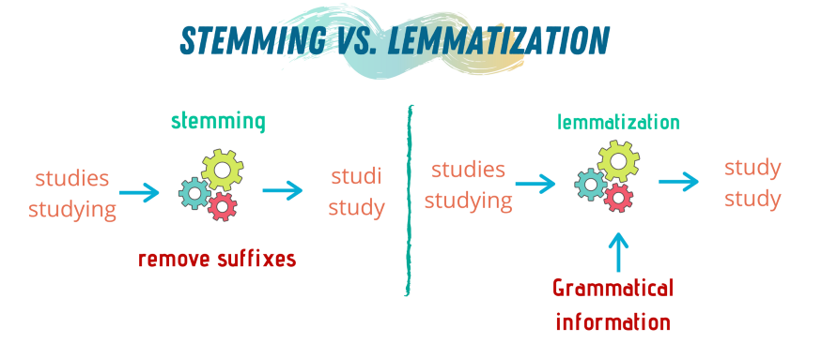
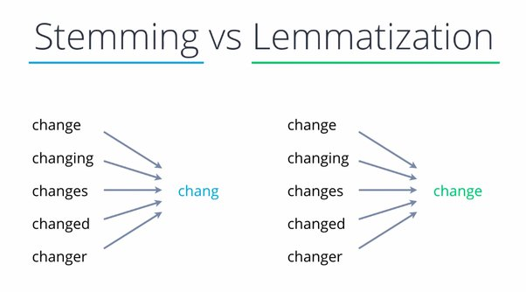

Slide 8
Text feature extraction
Techniques such as
Vocabulary/bag-of-words,
n-grams,
count vectorization, and
word embeddings
are used to represent text as numerical features in machine learning models.
Vocabulary or Bag-of-Words
Vocabulary in NLP refers to the set of unique words or tokens in a given text or corpus.

Slide 9
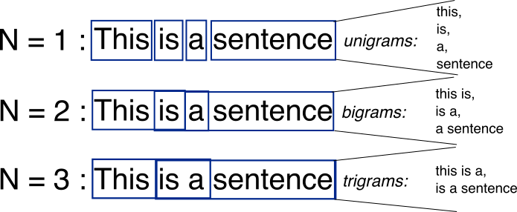
N-grams
An n-gram is a contiguous sequence of n items from a given sample of text or speech, where n can be any positive integer. In NLP, n-grams are often used to capture the context of words in a text.
N-grams are simply all combinations of adjacent words or letters of length n that you can find in your source text.

Slide 10
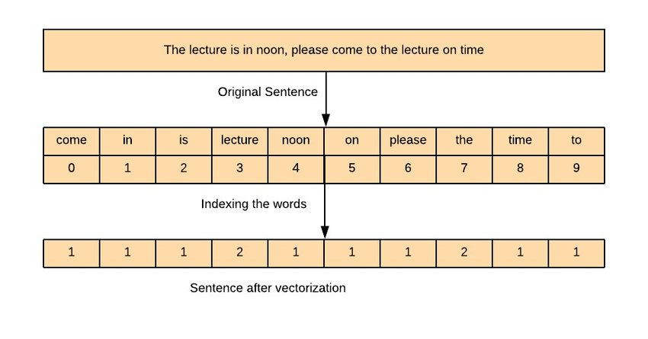
Count vectorization
Text vectorization is the process of converting text data into numerical vectors, which can be used as input for machine learning models.
One of the most common techniques for text vectorization is bag-of-words, which represents text as a bag (or multiset) of its words, disregarding grammar and word order but keeping track of the number of occurrences of each word.

Slide 11
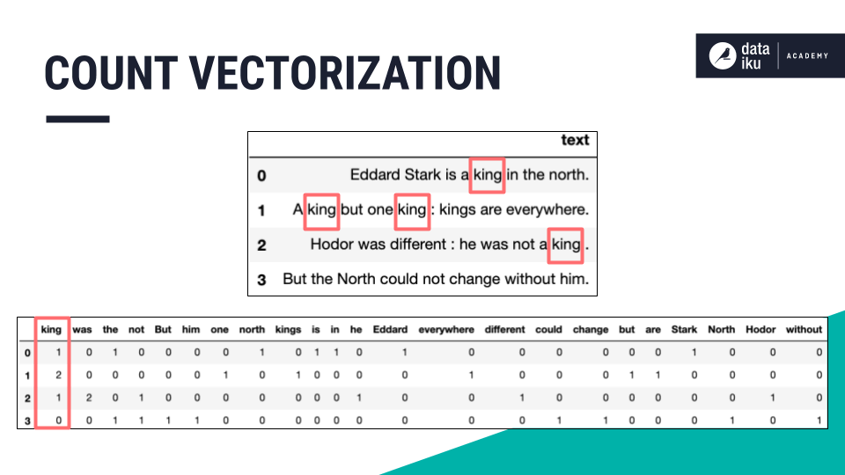

Slide 12
Text sort
Techniques for classifying text into predefined categories, such as sentiment analysis and spam detection.
Text sorting is one of the most important NLP tasks that involves assigning predefined categories or labels to a given piece of text.

Slide 13
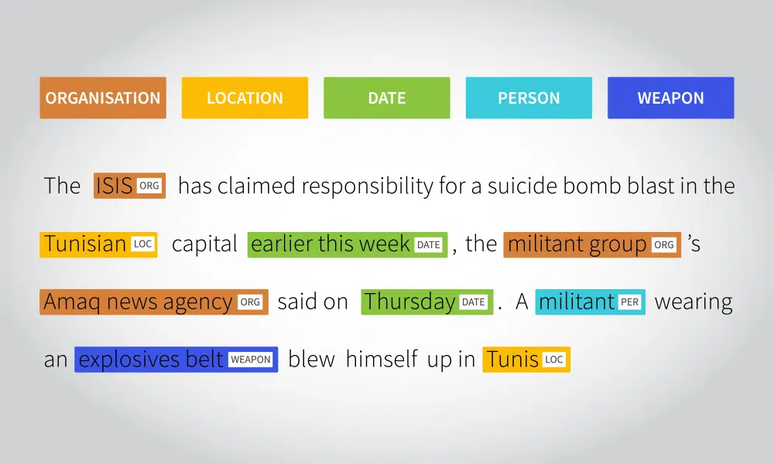
Named entity recognition
Named entity recognition are techniques for identifying and extracting named entities from text, such as people, organizations, and locations.
An entity can be thought of as a category type present in a given text. For example, the name of a certain personality, the name of an organization, location, etc.
https://spacy.io/usage

Slide 14
NER
How it works: The intricacies of NER can be broken down into several steps:
Tokenization. Before identifying entities, the text is split into tokens, which can be words, phrases, or even sentences. For instance, "Steve Jobs co-founded Apple" would be split into tokens like "Steve", "Jobs", "co-founded", "Apple".
Entity identification. Using various linguistic rules or statistical methods, potential named entities are detected. This involves recognizing patterns, such as capitalization in names ("Steve Jobs") or specific formats (like dates).
Entity classification. Once entities are identified, they are categorized into predefined classes such as "Person", "Organization", or "Location". This is often achieved using machine learning models trained on labeled datasets. For our example, "Steve Jobs" would be classified as a "Person" and "Apple" as an "Organization".
Contextual analysis. NER systems often consider the surrounding context to improve accuracy. For instance, in the sentence "Apple released a new iPhone", the context helps the system recognize "Apple" as an organization rather than a fruit.
Post-processing. After initial recognition and classification, post-processing might be applied to refine results. This could involve resolving ambiguities, merging multi-token entities, or using knowledge bases to enhance entity data.

Slide 15
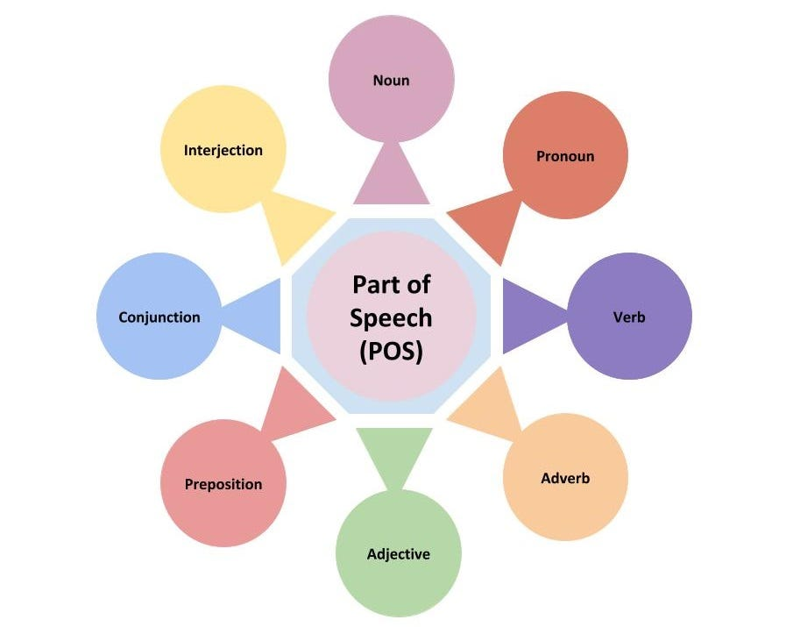
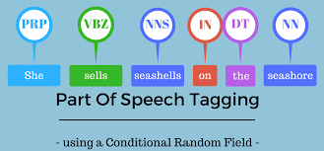
Part-of-speech tagging (P-o-S)
Part-of-speech tagging are approaches for identifying the parts of speech of words in a sentence, such as nouns, verbs, and adjectives.
NLTK library of python has a method called ‘pos_tag’ which allows tagging parts of speech with just one line of code.

Slide 16
The Different Parts of Speech and Their Tags
There are nine main parts of speech: noun, pronoun, verb, adjective, adverb, conjunction, preposition, interjection, and article.
Part-of-speech (POS) tags are labels that are assigned to words in a text, indicating their grammatical role in a sentence. The most common types of POS tags include:

Slide 17
The Different Parts of Speech and Their Tags
Noun (NN): A person, place, thing, or idea
Verb (VB): An action or occurrence
Adjective (JJ): A word that describes a noun or pronoun
Adverb (RB): A word that describes a verb, adjective, or other adverb
Pronoun (PRP): A word that takes the place of a noun
Conjunction (CC): A word that connects words, phrases, or clauses
Preposition (IN): A word that shows a relationship between a noun or pronoun and other elements in a sentence
Interjection (UH): A word or phrase used to express strong emotion

Slide 18
POS and categorise.
This is just a sample of the most common POS tags, different libraries and models may have different sets of tags, but the purpose remains the same — to categorise words based on their grammatical function.
Parts of speech can also be categorised by their grammatical function in a sentence. There are three primary categories: subjects (which perform the action), objects (which receive the action), and modifiers (which describe or modify the subject or object). Each primary category can be further divided into subcategories. For example, subjects can be further classified as simple (one word), compound (two or more words), or complex (sentences containing subordinate clauses).

Slide 19
Text generation
Techniques for generating new text based on a given input, such as machine translation and text summarization.
Text generation is the task of automatically producing new text based on a given input or model. It is a popular area of research in Natural Language Processing (NLP) and has numerous applications such as chatbots, content creation, and language translation.

Slide 20
Techniques for text generation.
Markov Chain: A statistical model that predicts the next word based on the probability distribution of the previous words in the text. It generates new text by starting with an initial state, and then repeatedly sampling the next word based on the probability distribution learned from the input text.
Sequence-to-Sequence (Seq2Seq) Model: A deep learning model that consists of two recurrent neural networks (RNNs), an encoder, and a decoder. The encoder takes the input text and produces a fixed-length vector representation, while the decoder generates the output text based on the vector representation.
Generative Adversarial Network (GAN): A deep learning model that consists of two neural networks, a generator, and a discriminator. The generator produces new text samples, while the discriminator tries to distinguish between the generated text and the real text. The two networks are trained in an adversarial manner, where the generator tries to produce more realistic text, while the discriminator tries to become better at recognizing fake text.
Transformer-based Models: Transformer models are a type of neural network architecture designed for NLP tasks, such as text classification and machine translation. They have been shown to perform well on text-generation tasks as well.

Slide 21
Text-to-Speech and Speech-to-Text
Techniques for converting speech to text and text to speech.
Text-to-Speech (TTS) and Speech-to-Text (STT) are two important applications of Natural Language Processing (NLP).
Text-to-Speech (TTS): TTS is a technology that allows computers to generate human-like speech from written text. The goal of TTS is to produce speech that is natural, expressive, and matches the intonation, rhythm, and prosody of human speech as closely as possible. TTS systems typically consist of two components: a text analysis module that analyzes the input text, and a speech synthesis module that converts the analyzed text into speech.

Slide 22
Speech-to-Text (STT):
STT is a technology that allows computers to transcribe spoken words into written text. STT systems are used in a wide range of applications, including voice-controlled virtual assistants, dictation software, and automatic speech recognition (ASR) systems. STT systems typically use acoustic models and language models to transcribe speech into text.

